Slide 1
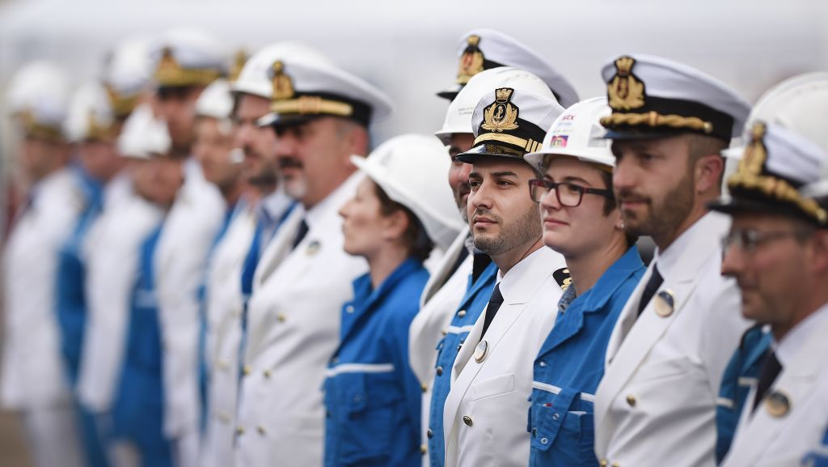

Slide 2

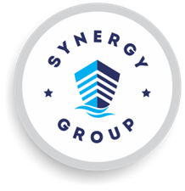
Crew Connect Call
A special platform using communication technology, where all ship’s crew and shore
team can interact with Directors, Marine Managers, Technical Managers, QHSE Team, and EMS
team.
Connect is the opportunity for the most junior rank on the vessel to connect with shore management and contribute to safety.

Slide 3
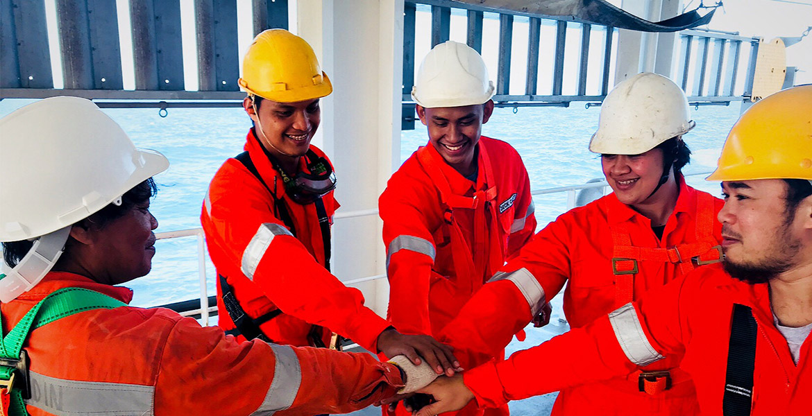
Crew Connect Call
Drive Synergy’s Core Values
Remove the challenges to open reporting and actively promote speaking up
Respectfully listen to concerns and resolve issues that may lead to unsafe work
Appreciate improvement
Identify how work is “actually done”
Identify gaps to improve performance
Learn from each other
Promote mental health and well-being
Drive psychological safety
Understand human factors

